Slide 1
Objective 9/6/11
Describe Characteristics of Living Organisms.
WU:
Define the term BIOTIC.
Define the term ABIOTIC.
List 10 biotic organisms and 10 abiotic things.

Slide 2
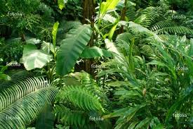
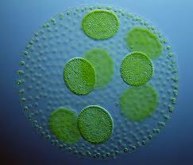
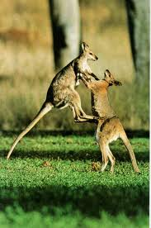
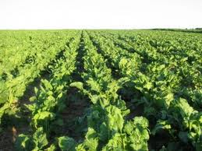
Biotic

Slide 3
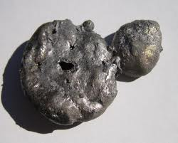
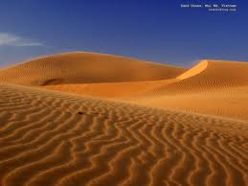
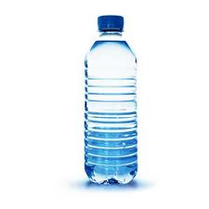
Abiotic

Slide 4
Objective
Identify processes of the Scientific Method.
WU:
Define the term Data.
Define the term Hypothesis.
What are the major steps in the scientific method (fig. 10 p. 15) List names.

Slide 5
Characteristics of Living Things
Nutrition (also called nourishment or aliment) is the provision, to cells and organisms, of the materials necessary (in the form of food) to support life. http://en.wikipedia.org/wiki/Nutrition
Nutrition: Materials necessary to support life.

Slide 6
Characteristics of Living Things
Respond to Environment = Stimuli (p.818)
All organisms react to changes in their environment.
Consists of Cells
All living organisms are made of cells.
Respiration (p 113)
Organisms break down molecules (food) in order to receive energy.

Slide 7
Characteristics of Living Things
Adaptation (p. 10)
A trait that gives an advantage to individual organisms.
Intake of Materials = Digestion (p.977) Absorption (p.983)
All organisms use materials from their environment in order to grow and develop.
Growth
Organisms increase in size over time.

Slide 8
Characteristics of Living Things
Movement
Organisms can change position in reaction to stimuli.
Excretion (p. 856 and 986)
All organisms eliminate waste products.
Synthesis The combination of two or more materials that together form something new.
Secretion The process of elaborating, releasing, and oozing chemicals.

Slide 9
Characteristics of Living Things
Regulation = Homeostasis
Maintenance of constant internal conditions.

Slide 10
Living or Non-Living?
SAND
SOIL

Slide 11
Living or Non-Living?

Slide 12
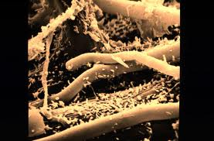
Soil Bacteria

Slide 13
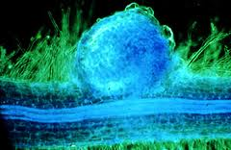
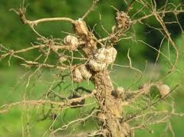
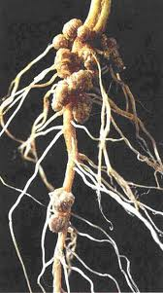
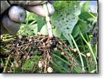
Bacteria and Plants

Slide 14
Food Chain

